Slide 1
Postgraduate Funding: Considering the Alternatives
Dr Luke Blaxill
enquiries@gradfunding.co.uk

Slide 2
‘Mainstream’ Funding
Research Councils and University Scholarships
Fees + mainentence or partial funding
Postgraduate Loans System for Masters + PhD

Slide 3
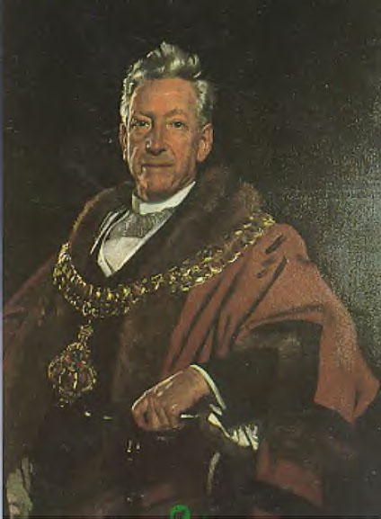
Alternative Funding Sources
Foundations
Learned Societies
Charities
Trusts

Slide 4
Access Alternative Guide to Postgraduate Funding Online
Go to: www.postgraduate-funding.com/gateway
Use Sussex’s PIN with an email address
Of your choice! PIN: 6789

Slide 5
Why?
Plan B to full funding - build up portfolio of awards
Unpredictable research costs
Unpredictable maintenance costs
Write-up costs.
Problems! Covid!

Slide 6
Who is this aimed at?
All postgraduate students
Prospective and current students
International, EU and UK students
Self-funded/partially-funded students
Fourth year PhD students
Fees and Living Costs
Research, travel and conference expenses

Slide 7
Alternative Funding Sources
Charities, Foundations, Trusts
Sir Richard Stapley Educational Trust
Vegetarian Charity
Leverhulme Trade Charities Trust
Bestway Foundation
Milly Apthorp Charitable Trust
Unusual Ones… Big &Tall and Kenitish

Slide 8
The Voluntary Sector
Not like Research Councils
Thousands of bodies- big to small
Varying budgets £500-£2000 per award each year.
Trick is to build up a portfolio of awards, domino effect
Not always academic, have their own agenda
Some are for hardship
Varying eligibility criteria: subject, age, nationality
Professional bodies & learned societies
Very diverse- something for everyone
Flexible: multiple deadlines per year
Apply in advance or during your course.

Slide 9
Finding Charities
Mission: make a list of potential funders
Do not discount a body unless its obviously inappropriate
Always check if body makes awards to individuals. Most charities only deal with organisations.

Slide 10
Finding Charities : 1. Looking Online
Your university’s funding pages
Alternative Guide to Postgraduate Funding
Scholarship Search, Postgraduate Studentships, Research Professional, Uni Grants
Charity search engines (eg TurntoUs).

Slide 11
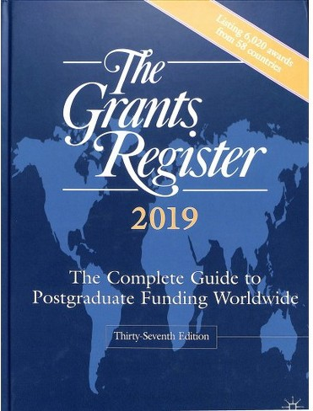
Finding Charities : 2. Local Library
The Educational Grants Directory
The Charities Digest
The Grants Register
The Directory of Grant Making Trust.

Slide 12
Finding Charities : 3. Learned Societies
e.g. Society for Neuroscience, Royal Historical Society
Interested in promoting their area
Grants for conferences and research
Small membership fee.

Slide 13
Finding Charities : 4. Ask for Advice
Education Division of Local Council (home address)
Simply ask at your university department.

Slide 14
Finding Charities : The Initial Approach
Condense your long list of potential funders into a smaller, manageable list
Ask if you’re eligible to apply with a short letter, email or phone call
Include stamped, self-addressed envelope
Example template letter in the Alternative Guide to Postgraduate Funding.

Slide 15
Applying:
General Tips
Decide what is body’s priority: academic, hardship or does it have its own agenda?
500-800 word personal statement
Strong arguments- why fund you?
Make research easy to understand
List all the other bodies applied to/have received money from!
Clear financial plan
Future career plans.

Slide 16
Applying:
Research, Conferences & Travel
Make sure of eligibility/membership
Plan in advance
Be sure of research relevance
Detailed financial statement for the relevant period
Mention other sources of funding for the relevant period
Don’t talk about your general financial situation
Emphasise the benefits from attending conference/ doing this research
Maintain good relations with sponsors- reports especially important here.

Slide 17
Applying:
Financial Statement
Always required by charities
List all bodies you’ve applied to this year with results
Itemise your income and expenditure for the year
Request an amount based on the deficit between income and expenditure, but also the amount the charity typically awards
Don’t always ask for the maximum, a gamble
State what you will be spending the grant on: fees, travel, living costs?
For research/travel/conference, support your cost estimates with evidence for the relevant period.

Slide 18
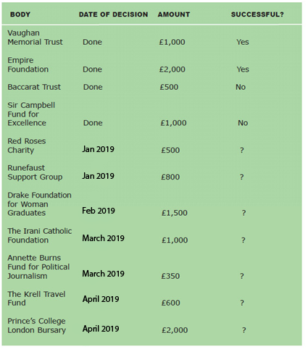
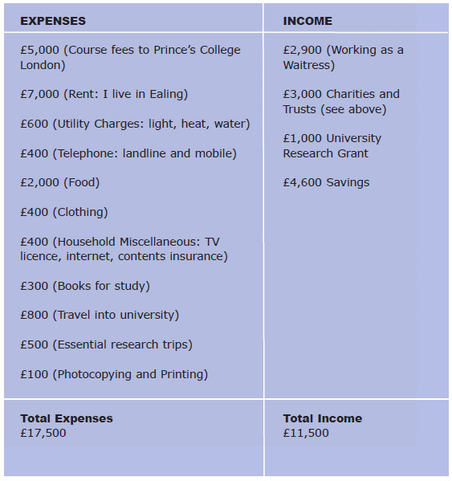
Applying:
Model Financial Statement

Slide 19
Applying:
References and Aftermath
Get references as early as possible
Be neat and diligent with forms
If you’re successful, write to say thanks and write a short report at end of year
Can renew awards each year.

Slide 20
Golden Rules
First, make sure you’re eligible
Understand a charity's priorities and tailor your application
Keep your research/ application simple
Show how your research might benefit society
Have a career plan
Show a clear financial plan
Never give up.

Slide 21
Thank You!
Dr Luke Blaxill
enquiries@gradfunding.co.uk

